Slide 1

Flux And ReDUX
Sonal Karle &
Sushmita Roy

Slide 2
Why Flux?
Flux is an application architecture that Facebook uses internally for building the client-side web application with React.
It is not a library nor a framework. It is neither a library nor a framework. It is a kind of architecture that complements React as view and follows the concept of Unidirectional Data Flow model.
It is useful when the project has dynamic data, and we need to keep the data updated in an effective manner.
It reduces the runtime errors.

Slide 3
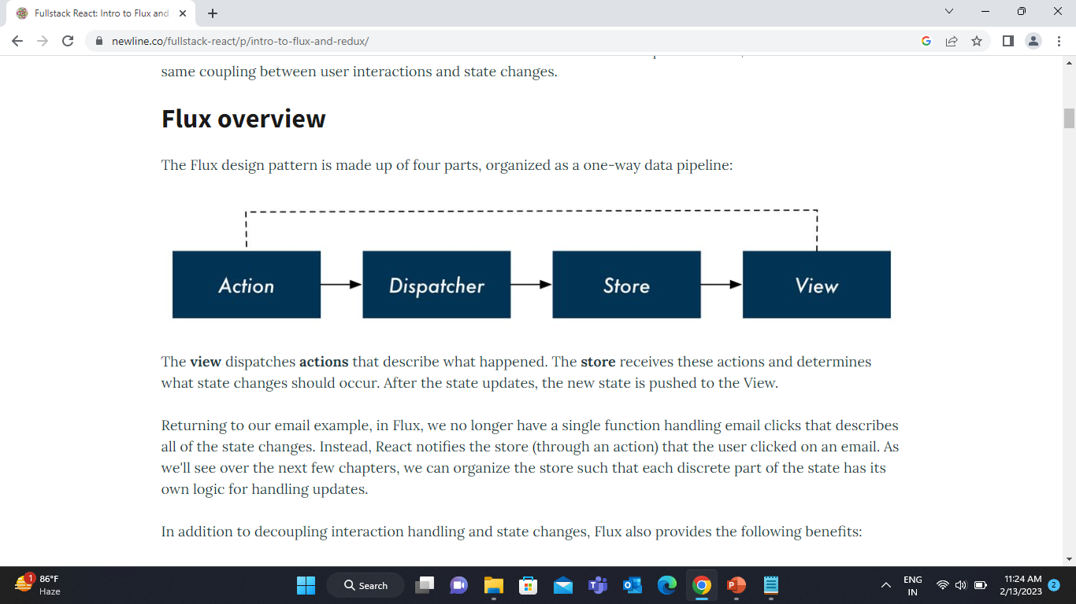
Flux applications have three major roles in dealing with data:
Dispatcher
Stores
Views (React components)
Command for install flux
npm install flux

Slide 4
Dispatcher:
It is a central hub for the React Flux application and manages all data flow of your Flux application.
It is a registry of callbacks into the stores
Distributing the actions to the stores. All stores register itself and provide a callback.
It is a place which handled all events that modify the store.
SN | Methods | Descriptions
1. | register() | It is used to register a store's action handler callback.
2. | unregister() | It is used to unregisters a store's callback.
3. | waitFor() | It is used to wait for the specified callback to run first.
4. | dispatch() | It is used to dispatches an action.
5. | isDispatching() | It is used to checks if the dispatcher is currently dispatching an action.

Slide 5
Stores
It primarily contains the application state and logic.
It is similar to the model in a traditional MVC
It is used for maintaining a particular state within the application, updates themselves in response to an action, and emit the change event to alert the controller view
Views
It is also called as controller-views. It is located at the top of the chain to store the logic to generate actions and receive new data from the store.
It is a React component listen to change events and receives the data from the stores and re-render the application.
Action
The dispatcher method allows us to trigger a dispatch to the store and include a payload of data, which we call an action.
It is an action creator or helper methods that pass the data to the dispatcher.

Slide 6
Advantage of Flux
It is a unidirectional data flow model which is easy to understand.
It is open source and more of a design pattern than a formal framework like MVC architecture.
The flux application is easier to maintain.
The flux application parts are decoupled.

Slide 7
What is Redux?
Redux is an open-source JavaScript library used to manage application state.
React Redux is the official React binding for Redux. It allows React components to read data from a Redux Store, and dispatch Actions to the Store to update data.
Redux helps apps to scale by providing a sensible way to manage state through a unidirectional data flow model. React Redux is conceptually simple.

Slide 8
Redux was inspired by Flux. Redux studied the Flux architecture and omitted unnecessary complexity.
Redux does not have Dispatcher concept.
Redux has an only Store whereas Flux has many Stores.
The Action objects will be received and handled directly by Store

Slide 9
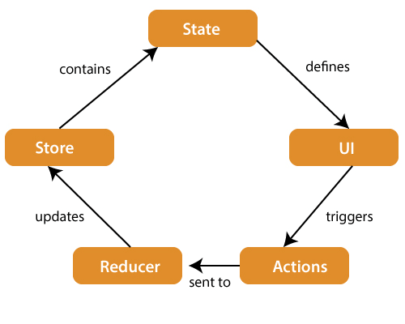
React Architecture :
Command to install Redux:
npm install @reduxjs/toolkit react-redux

Slide 10
STORE: A Store is a place where the entire state of your application lists. It manages the status of the application and has a dispatch(action) function. It is like a brain responsible for all moving parts in Redux.
ACTION: Action is sent or dispatched from the view which are payloads that can be read by Reducers. It is a pure object created to store the information of the user's event. It includes information such as type of action, time of occurrence, location of occurrence, its coordinates, and which state it aims to change.
REDUCER: Reducer read the payloads from the actions and then updates the store via the state accordingly. It is a pure function to return a new state from the initial state.

